Slide 1


Slide 2
Project Hourglass
Time-Based Analytics
Sponsor: Rakesh Kumar
Team
Eric Weiss
Patrick Ferner
Jordy Guntur

Slide 3
Practicality & Importance
Notes:
Time-based analytics allows us to use the data we have to predict data that we don’t have
It can be used in multiple domains: predicting stock market changes, weather forecasting and even traffic
In our modern-day, lots of data is available that we are free to leverage
The data speaks for itself and holds the truth that we seek

Slide 4
millions+
MET,20161108143009.477243,MET,47.900000,47410
Notes:
We were given millions of tick by tick trade prices that were fed to our time-based model and our goal was to build a sophisticated tool to retrieve, store and analyze massive volumes of time series data.

Slide 5
Challenges
Building an effective model for the data
Things we had to consider: how much to sample, prevent overfitting, performance vs accuracy, computing correlation
Parsing and storing the data
Efficient capture, store, access, process, and prediction times from a big data set

Slide 6
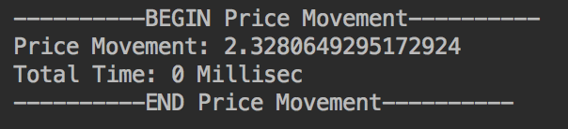
Level 1 Retrieve the price movement for a given security over a specified period of time
INPUT:
TICKER: MET
YYYY:MM:DD:HH:MM:SS.Millisec
START: 20161107141219.161062
END:20161107143104.626741
OUTPUT:
Notes:
Input output

Slide 7
Implementation
HashMap of <Ticker, Company>
Each Company has an ArrayList of Transactions
Constant time operation
Given two date ranges and ticker, fetch the company, lookup the correct transaction at the right dates and using those values, calculate price movement
Now we have the price movement over a period of time!
Notes:
Complexity time constant time

Slide 8
Level 2: Retrieve high price, low price for a given security within a specified time range

Slide 9
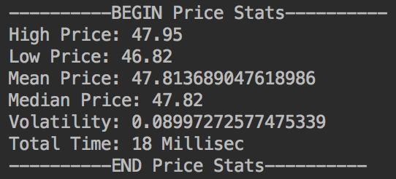
INPUT:
TICKER: MET
YYYY:MM:DD:HH:MM:SS.Millisec
START: 20161107141219.161062
END: 20161107143442.338851
OUTPUT (Above and Beyond)
* More test cases available on public repo

Slide 10
Implementation
Same as previous, we fetch the company and its list of transactions. At the correct dates, we calculated the high, low, mean and median.
We utilized the Apache Commons Math library to calculate the volatility.
To reduce runtime, we use a separate HashMap that hashes to the correct index at the ArrayList of transactions of the specified date range.

Slide 11
Level 3: Plot the price movement for a given security

Slide 12
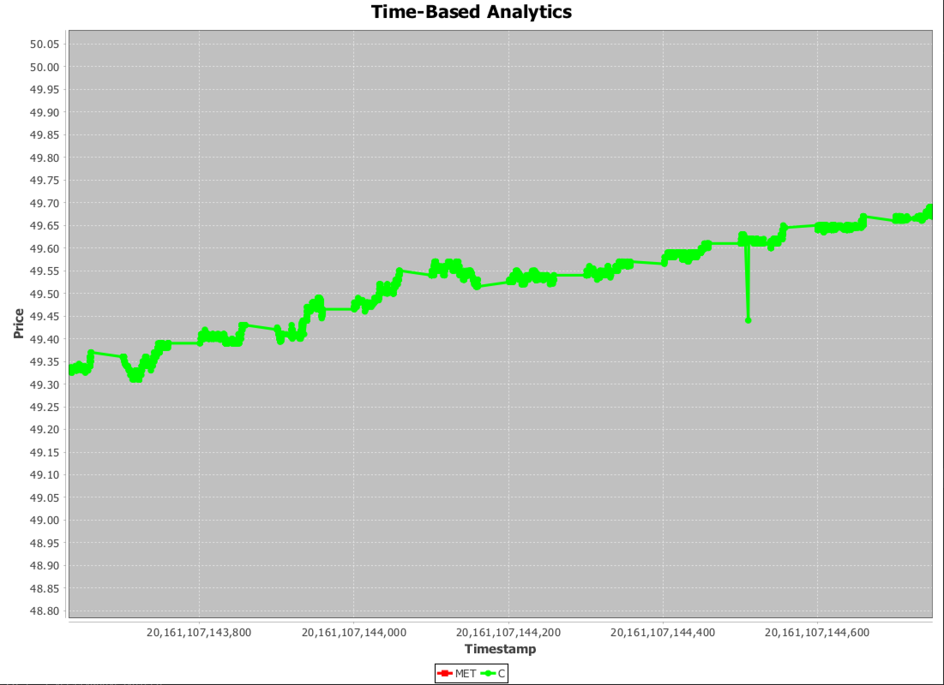
Price Movements:
TICKER: C
START: 20161107141219.428322
END: 20161107161643.746241
* Utilized Java Jfree library
Notes:
Write implementation

Slide 13
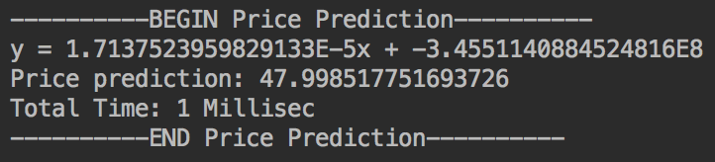
Level 4 Predict the security prices based on price movement
INPUT:
TICKER: MET
YYYY:MM:DD:HH:MM:SS.Millisec
START: 20161107141219.161062
END: 20161107150230.585522
FUTURE: 20161107150230.985522
OUTPUT
Notes:
Include data sample dates and question mark for future
Include prices
Time of us election

Slide 14
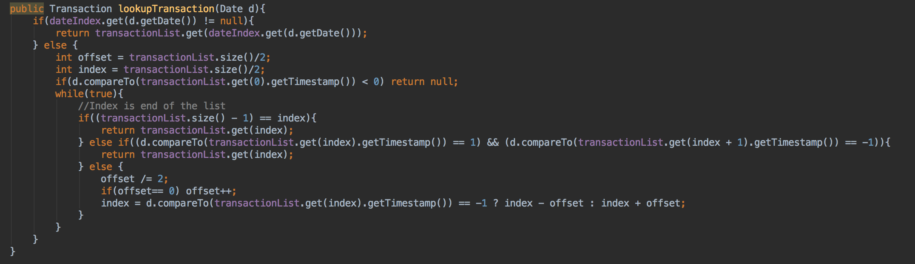
Level 5 If security price is not available on a given point of time, trace back to find last price of security
Utilized Binary Search to find closest earliest transaction

Slide 15
We implemented parts of project 5 related to time-based analytics

Slide 16
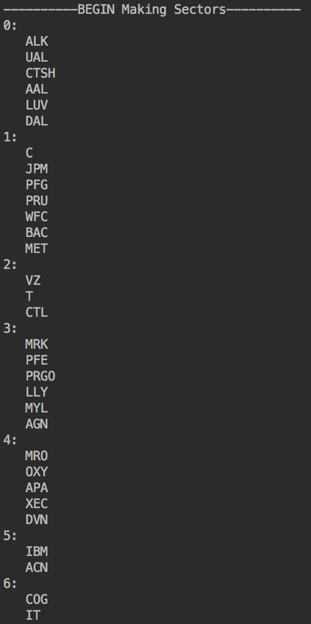
Grouping all securities together based on sector -> (*Correlation)
Industrial (Airlines)
Financials
Telecommunication
Healthcare
Energy (Oil & Gas Exploration)
Information Technology

Slide 17
Plot price movements of securities under each sector Since we already grouped the securities by sector, calculated price movements per security, we now plot the points.

Slide 18
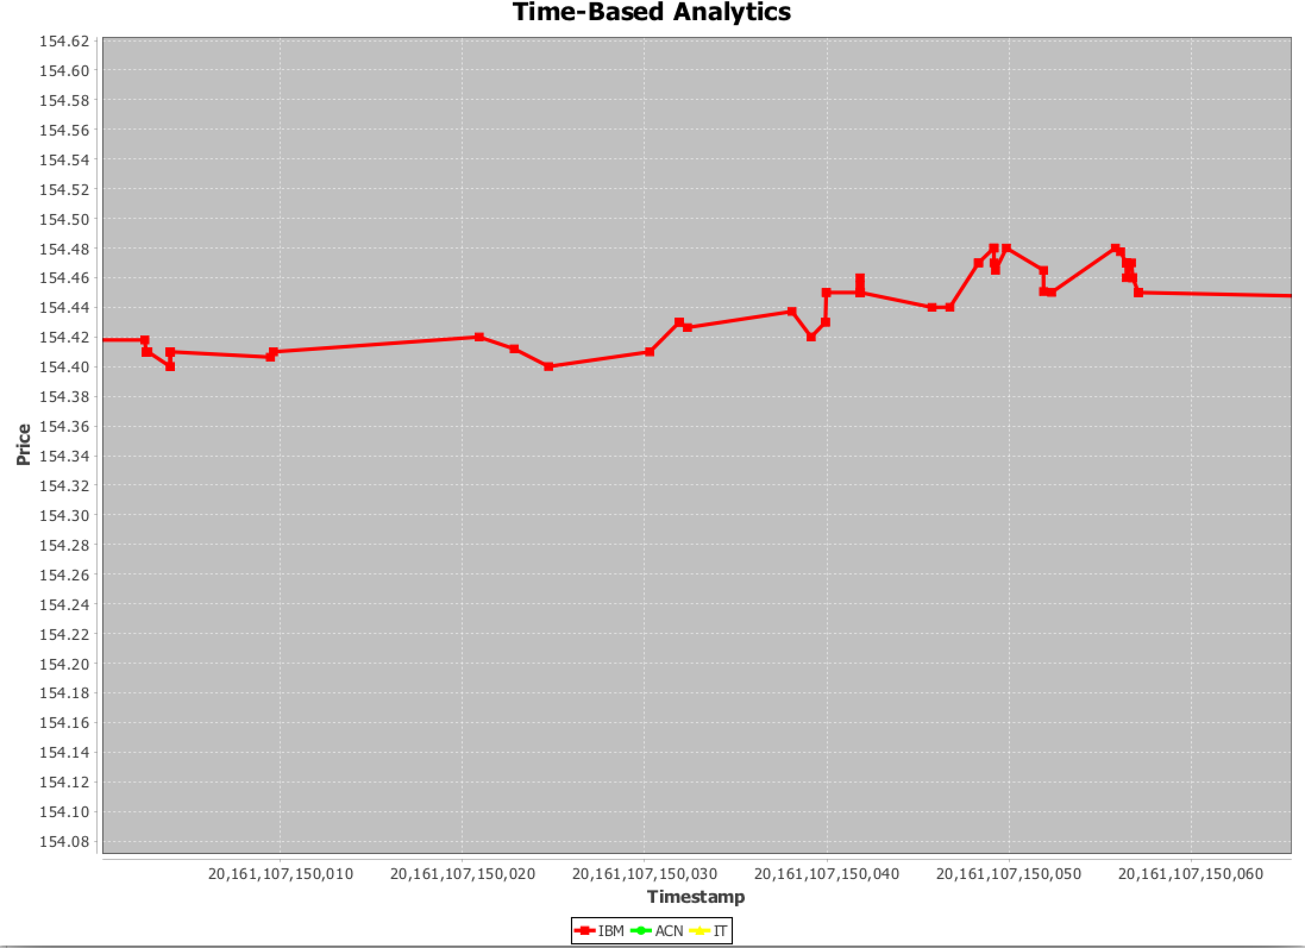
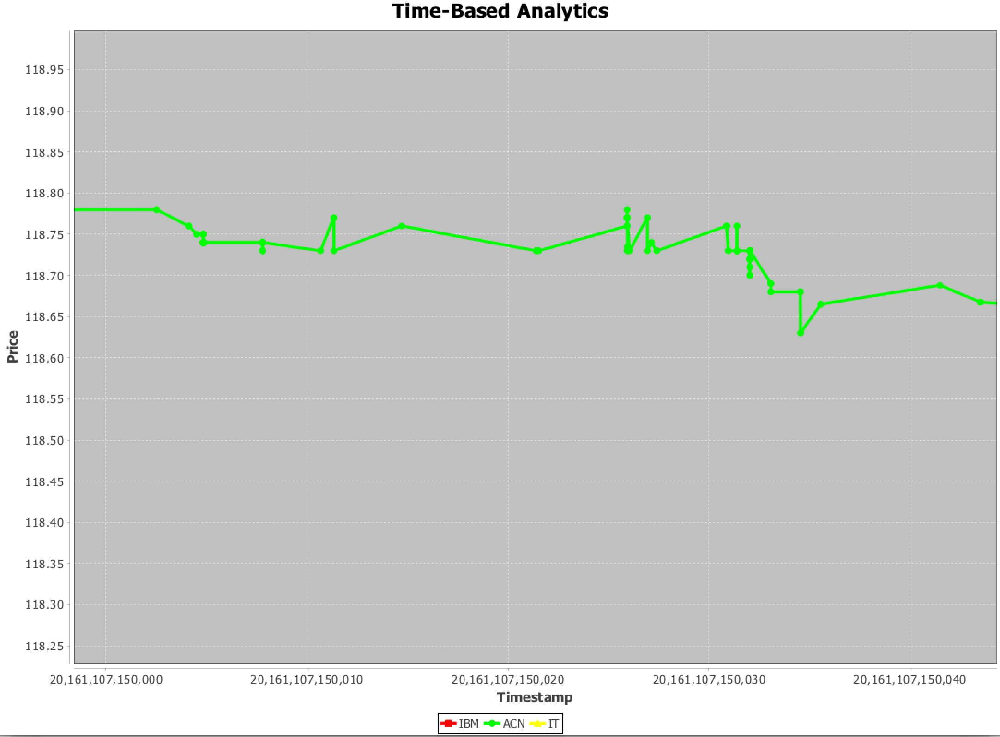
Information Technology Sector
ACN
IBM

